Slide 1
Naïve Bayes Classifier

Slide 2
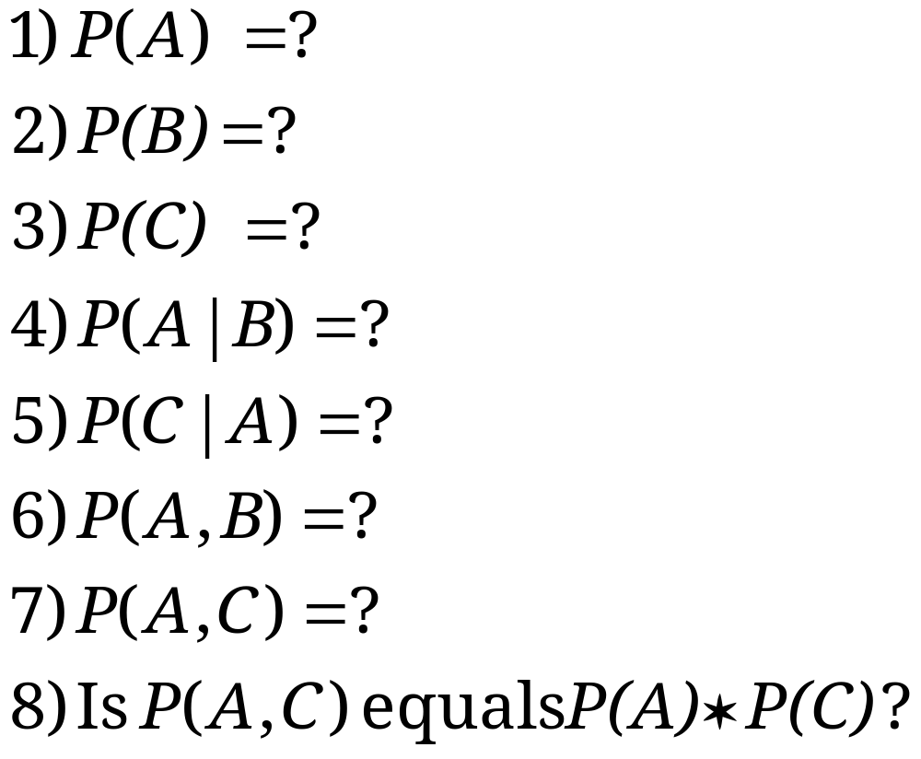
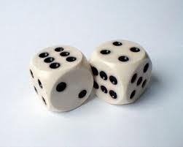
QUIZZ: Probability Basics
Quiz: We have two six-sided dice. When they are tolled, it could end up with the following occurance: (A) dice 1 lands on side “3”, (B) dice 2 lands on side “1”, and (C) Two dice sum to eight. Answer the following questions:

Slide 3
Outline
Background
Probability Basics
Probabilistic Classification
Naïve Bayes
Example: Play Tennis
Relevant Issues
Conclusions

Slide 4







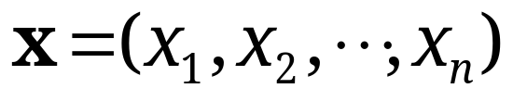
Probabilistic Classification
Establishing a probabilistic model for classification
  Discriminative model
Vectors for teaching
Probability of seeing a member of this class
We want to know probabilities of classes for events x1
What is a discriminative Probabilistic Classifier?
Discriminative
Probabilistic Classifier
Probability that when they show me a fruit it will be an apple
We know events x1, … xn

Slide 5



Probabilistic Classification
Establishing a probabilistic model for classification (cont.)
  Generative model
Probability that this fruit is an orange
Probability that this fruit is an apple
Generative
Probabilistic Model
for Class 1
Generative
Probabilistic Model
for Class 2
Generative
Probabilistic Model
for Class L
Vectors of random variables

Slide 6
Background: methods to create classifiers
There are three methods to establish a classifier
a) Model a classification rule directly
  Examples: k-NN, decision trees, perceptron, SVM
  b) Model the probability of class memberships given input data
  Example: perceptron with the cross-entropy cost
c) Make a probabilistic model of data within each class
  Examples: naive Bayes, model based classifiers
a) and b) are examples of discriminative classification
c) is an example of generative classification
b) and c) are both examples of probabilistic classification

Slide 7



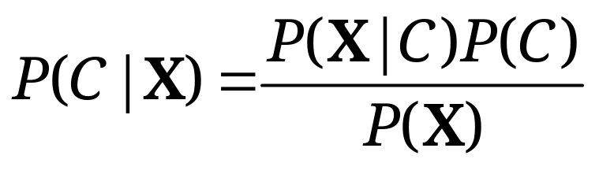

LAST LECTURE REMINDER: Probability Basics
We defined prior, conditional and joint probability for random variables
  Prior probability:
  Conditional probability:
  Joint probability:
  Relationship:
  Independence:
Bayesian Rule

Slide 8
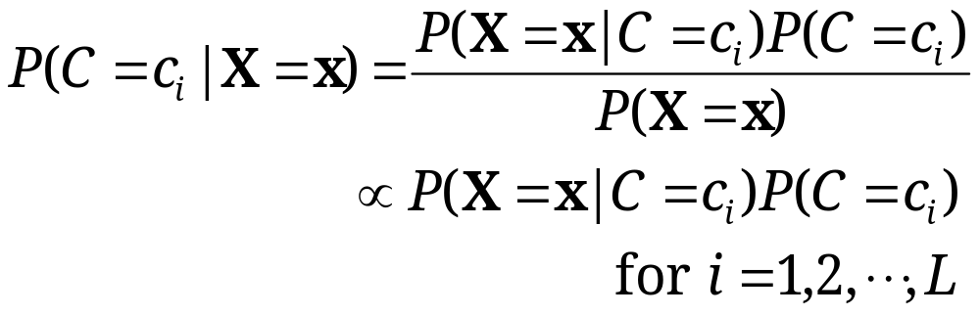
Method: Probabilistic Classification with MAP
MAP classification rule
  MAP: Maximum A Posterior
  Assign x to c* if
Method of Generative classification with the MAP rule
  Apply Bayesian rule to convert them into posterior probabilities
  Then apply the MAP rule
We use this rule in many applications

Slide 9
Naïve Bayes Classifier

Slide 10
NAÏVE BAYES easy example from my middle school student girl

Slide 11
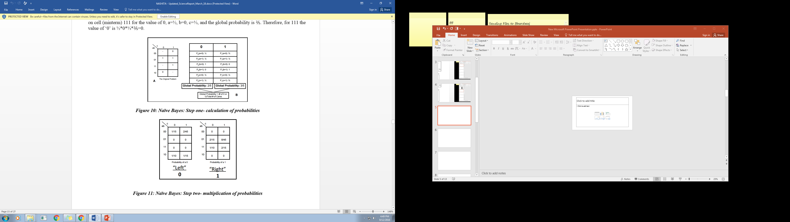

Probability of output 0 in a=0
Probability of output 1 in a=0
2 zeros out of 5 minterms (cares)
3 ones out of 5 minterms (cares)

Slide 12
P(a=0) * p(b=0) * p(c=0) * p(0)_{Global}= 1/3*1*1/2 (*2/5)= 1/6* 2/5 = 1/15
P(a=0) * p(b=0) * p(c=1) * p(0)_{Global}= 1/3*1*1/3 (*2/5)= 1/9* 2/5 = 2/45
P(a=1) * p(b=1) * p(c=1) * p(1)_{Global} = 1/2*1*2/3 (*3/5)= 1/3* 3/5 = 3/15
3/15

Slide 13
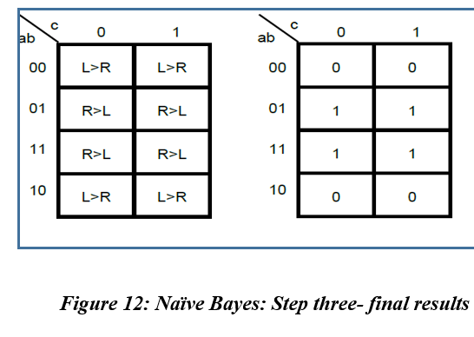

Slide 14
Naïve Bayes Classifier generalization and theory

Slide 15

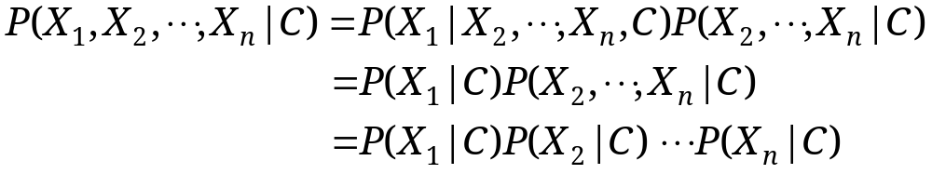
Naïve Bayes
For a class, the previous generative model can be decomposed by n generative models of a single input.
Bayes classification
  Difficulty: learning the joint probability
Naïve Bayes classification
  Assumption that all input attributes are conditionally independent!
  MAP classification rule: for
Product of individual probabilities

Slide 16
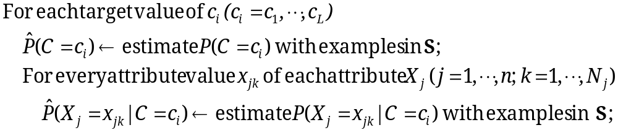


Naïve Bayes
Naïve Bayes Algorithm (for discrete input attributes) has two phases
  1. Learning Phase: Given a training set S,
  Output: conditional probability tables; for elements
  2. Test Phase: Given an unknown instance ,
  Look up tables to assign the label c* to X’ if

Slide 17

Tennis Example
Example: Play Tennis

Slide 18
The learning phase for tennis example
P(Play=Yes) = 9/14
P(Play=No) = 5/14
We have four variables, we calculate for each
Outlook | Play=Yes | Play=No
Sunny | 2/9 | 3/5
Overcast | 4/9 | 0/5
Rain | 3/9 | 2/5
Temperature | Play=Yes | Play=No
Hot | 2/9 | 2/5
Mild | 4/9 | 2/5
Cool | 3/9 | 1/5
Humidity | Play=Yes | Play=No
High | 3/9 | 4/5
Normal | 6/9 | 1/5
Wind | Play=Yes | Play=No
Strong | 3/9 | 3/5
Weak | 6/9 | 2/5

Slide 19
Problem
Given the data as found in last slide:
Find for a new point in space (vector of values) to which group it belongs (classify)

Slide 20
The test phase for the tennis example
Test Phase
  Given a new instance of variable values,
  x’=(Outlook=Sunny, Temperature=Cool, Humidity=High, Wind=Strong)
  Given calculated Look up tables
  Use the MAP rule to calculate Yes or No
P(Outlook=Sunny|Play=Yes) = 2/9
P(Temperature=Cool|Play=Yes) = 3/9
P(Huminity=High|Play=Yes) = 3/9
P(Wind=Strong|Play=Yes) = 3/9
P(Play=Yes) = 9/14
P(Outlook=Sunny|Play=No) = 3/5
P(Temperature=Cool|Play==No) = 1/5
P(Huminity=High|Play=No) = 4/5
P(Wind=Strong|Play=No) = 3/5
P(Play=No) = 5/14
P(Yes|x’): [P(Sunny|Yes)P(Cool|Yes)P(High|Yes)P(Strong|Yes)]P(Play=Yes) = 0.0053
P(No|x’): [P(Sunny|No) P(Cool|No)P(High|No)P(Strong|No)]P(Play=No) = 0.0206
Given the fact P(Yes|x’) < P(No|x’), we label x’ to be “No”.

Slide 21
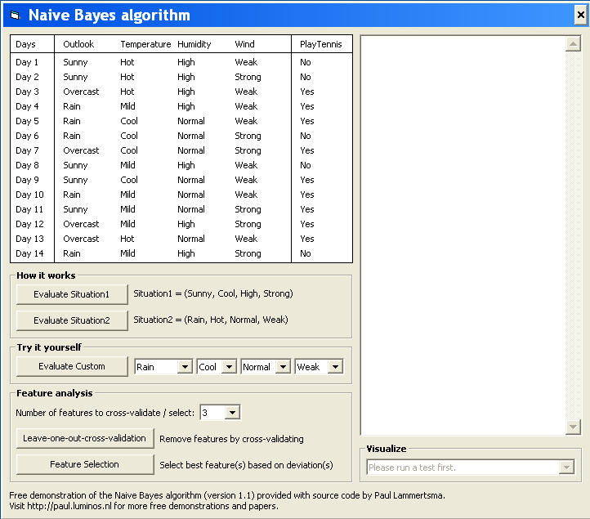
Example: software exists
Test Phase
  Given a new instance,
  x’=(Outlook=Sunny, Temperature=Cool, Humidity=High, Wind=Strong)
  Look up tables
  MAP rule
From previous slide
P(Outlook=Sunny|Play=Yes) = 2/9
P(Temperature=Cool|Play=Yes) = 3/9
P(Huminity=High|Play=Yes) = 3/9
P(Wind=Strong|Play=Yes) = 3/9
P(Play=Yes) = 9/14
P(Outlook=Sunny|Play=No) = 3/5
P(Temperature=Cool|Play==No) = 1/5
P(Huminity=High|Play=No) = 4/5
P(Wind=Strong|Play=No) = 3/5
P(Play=No) = 5/14
P(Yes|x’): [P(Sunny|Yes)P(Cool|Yes)P(High|Yes)P(Strong|Yes)]P(Play=Yes) = 0.0053
P(No|x’): [P(Sunny|No) P(Cool|No)P(High|No)P(Strong|No)]P(Play=No) = 0.0206
Given the fact P(Yes|x’) < P(No|x’), we label x’ to be “No”.

Slide 22
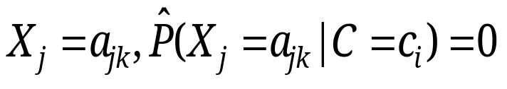
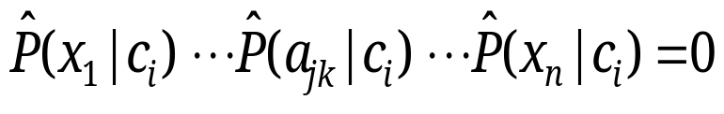
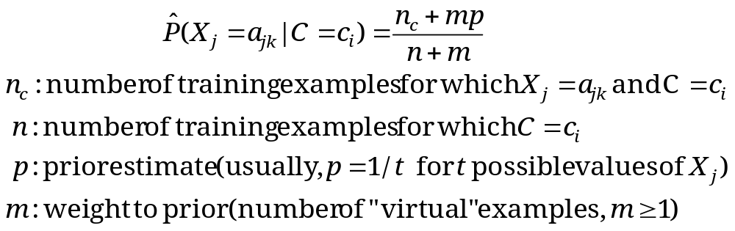
Issues Relevant to Naïve Bayes
Violation of Independence Assumption
  For many real world tasks,
  Nevertheless, naïve Bayes works surprisingly well anyway!
Zero conditional probability Problem
  Such problem exists when no example contains the attribute value
  In this circumstance, during test
  For a remedy, conditional probabilities are estimated with
Events are correlated

Slide 23
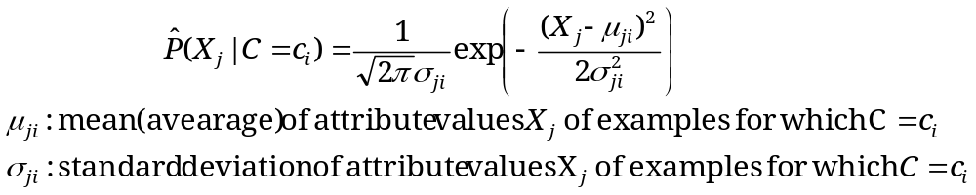




Continuous-valued Input Attributes
What to do in the case of Continuous Valued Inputs?
  Numberless values for an attribute
  Conditional probability is then modeled with the normal distribution
  Learning Phase:
  Output: normal distributions and
  Test Phase:
    Calculate conditional probabilities with all the normal distributions
    Apply the MAP rule to make a decision

Slide 24
Conclusion on Naïve Bayes classifiers
Naïve Bayes is based on the independence assumption
  Training is very easy and fast; just requiring considering each attribute in each class separately
  Test is straightforward; just looking up tables or calculating conditional probabilities with normal distributions
Naïve Bayes is a popular generative classifier model
  Performance of naïve Bayes is competitive to most of state-of-the-art classifiers even in presence of violating independence assumption
  It has many successful applications, e.g., spam mail filtering
  A good candidate of a base learner in ensemble learning
  Apart from classification, naïve Bayes can do more…

Slide 26
Sources
Ke Chen

